Slide 1
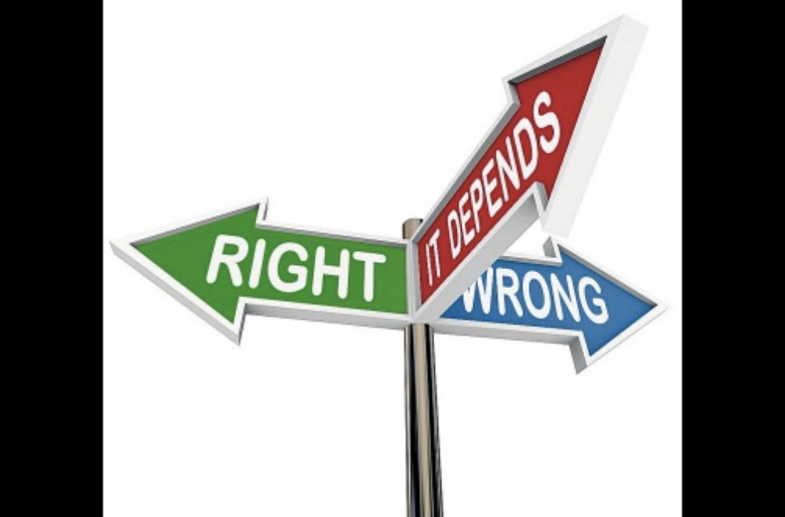
MORAL DILEMMAS AND THE
MINIMUM REQUIREMENTS OF
MORALITY
Prepared by: Eduardo S. Sucob, Jr.

Slide 2
Objectives:
At the end of the lesson, the students should be able to:
Differentiate the levels of moral dilemma.
Identify the minimum requirements of morality.
Evaluate the soundness and validity of the arguments in a moral dilemma.
Construct arguments and counter arguments in the higher level of moral dilemmas.

Slide 3
Angelito started to show mental imbalances these past few days. He was noticed by his friends and family to have sudden outbursts of anger without reason. To protect him from harming himself and others, his family has kept all sorts of deadly weapons in the house within his sight and reach.
You have borrowed from Angelito a Swiss knife which you used then in your school project. You thought you have lost it, but eventually found it in your drawer.
Is it right to return the borrowed thing to Angelito?

Slide 4
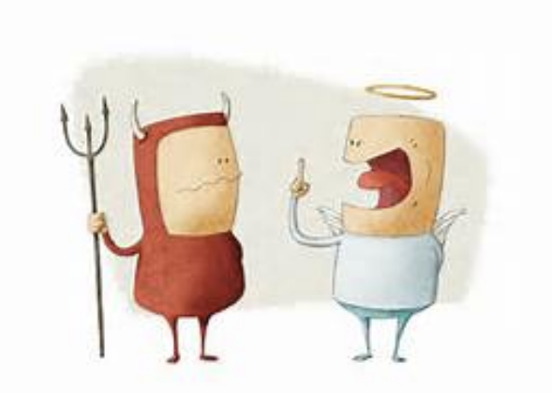
WHAT IS A MORAL DILEMMA?
is a complex situation that often involves an apparent mental conflict between moral imperatives, in which to obey one would result in transgressing another.
Sometimes called ethical paradoxes, these dilemmas invoke an attempt to refute an ethical system or moral code, or to improve it so as to resolve the paradox.

Slide 5
WHAT IS A MORAL DILEMMA?
The crucial features of a moral dilemma are these:
  the agent is required to do each of two (or more) actions;
  the agent can do each of the actions; but the agent cannot do both (or all) of the actions.
  The agent thus seems condemned to moral failure; no matter what s/he does, s/he will do something wrong (or fail to do something that she ought to do).

Slide 6
EXAMPLE OF A MORAL DILEMMA
A student whose brother had been killed in the German offensive of 1940. The student wanted to avenge his brother and to fight forces that he regarded as evil. But the student’s mother was living with him, and he was her one consolation in life. The student believed that he had conflicting obligations. The student is being torn between two kinds of morality: one of limited scope but certain efficacy, personal devotion to his mother; the other of much wider scope but uncertain efficacy, attempting to contribute to the defeat of an unjust aggressor.

Slide 7
TYPES OF MORAL DILEMMAS
Epistemic conflicts – This type of dilemma involves conflicts between two (or more) moral requirements and the agent does not know which of the conflicting requirements takes precedence in her situation.
Ontological conflicts – This dilemma involves conflicts between two (or more) moral requirements, and neither is overridden. This is not simply because the agent does not know which requirement is stronger; neither is. Genuine moral dilemmas, if there are any, are ontological.

Slide 8
TYPES OF MORAL DILEMMAS
Self-imposed moral dilemmas – arise because of the agent's own wrongdoing (Aquinas; Donagan 1977, 1984; and McConnell 1978).
Example: An agent made two promises that he knew conflicted, then through his own actions he created a situation in which it is not possible for him to discharge both of his requirements.

Slide 9
THREE LEVELS OF MORAL DILEMMAS
Personal/Individual Moral Dilemmas – personal in nature
Examples:
a. deciding which parent to live with
b. deciding whether to let their family starve or steal bread from someone else

Slide 10
THREE LEVELS OF MORAL DILEMMAS
Organizational Dilemmas – a dilemma that exist within an organization or a particular sector. It refers to a problem of reconciling inconsistencies between individual needs and aspirations on the one hand, and the collective purpose of the organization on the other.
Example:
a. a manager deciding which employee to promote

Slide 11
THREE LEVELS OF MORAL DILEMMAS
Systematic/Structural Dilemma – This dilemma refers to ongoing search for satisfactory system. Managers rarely face well defined problems with clear cut solutions, instead, they confront enduring dilemmas like trade offs, without easy answers.
Example:
a. The President deciding which economic system to follow.

Slide 12
University A spends a minimum of 100K for European trips of Dean Torres. The trips involve paper presentations, attendance to international conferences, linkages with other universities abroad, and benchmarking of best practices.
However, unknown to the management of University A, Dean Torres is also employed as an academic officer in University B. The latter is aware of the employment of Dean Torres in University A. When the management of University B learned about the trip of Dean Torres in Europe, it requested him to visit two schools (in Europe) regarding its 3 programs under conception. Since University B would only be a rider on Dean Torres trips, it offers him 50K as personal allowance.

Slide 13
Dean Torres was glad about the offer. He needed money for the upcoming kidney operation of his wife. For his European trip, he is entitled for full transportation, accommodation and personal allowances by University A, intended for the paper presentation and 2 additional days for ocular inspections/visitations of HEIs in a location of his choice.
For such, he is anticipating additional 30K savings for the allowances to be provided by University A, since he has already communicated to some friends and relatives to accommodate him for his upcoming trip.

Slide 14
(However), University A is undergoing budget tightening due to decrease in enrolment as a result of K to12 implementation.
Dean Torres argues that the upcoming European trip (his 3rd in a row) has been approved by the Academic Council prior to the implementation of the K to12. Furthermore, the Dean argues that the said official trip is necessary to maintain the current autonomous status of the University (A) as well as the level 4 accreditation of his College’s two prime programs.

Slide 15
Unknown to Dean Torres, the President of University A is aware of his employment in University B because her brother in law is the current president of University B. She is likewise aware of the 50K subsidy to be provided by University B to him (Dean Torres).
Her brother in law have talked to her secretly to support the European trip of Dean Torres, because if such would push through, it would definitely benefit the two universities.
The President does not know what to do. Her brother in law was instrumental to her installation as president of University A because of his numerous connections in the academe. He was her principal sponsor too in her pursuit of her Ph.D abroad.

Slide 16
Conflict of Interest
a situation in which a person is in a position to derive personal benefit from actions or decisions made in their official capacity.
  Example: A Teacher pushing for the resumption of classes because she owns a canteen and boarding houses near the university area.

Slide 17
The process of making a moral decision can be as important as the decision itself.
Many ethical decisions that people encounter are so complex that it is easy to exhaust oneself talking around the problem without actually making any progress towards resolving it.

Slide 18
MORALITY AND REASON
Moral Philosophy is an attempt to achieve a systematic understanding of the nature of morality and what it requires of us, “how we ought to live… and why”.
The Role of Reason: Reason is a faculty that is used by man in dealing with issues.
Moral judgements are not a matter of personal preferences or tastes.

Slide 19
MORAL REASONING is a process by which one thinks about the moral dilemma in ways that:
Identify (as comprehensively as possible) the morally relevant aspects of the situation;
Weigh the significance of the morally relevant aspects, giving due importance to the views of the persons’ concerned of what constitutes benefit and harm;
Identify (as comprehensively as possible)all the possible actions that could be pursued and their most likely consequences; and,
Consider all of the above elements and come to a decision about which action is reasoned to be the most ethically justified.

Slide 20
On Impartiality:
Each individual’s interests are equally important.
Therefore, each must acknowledge that other person’s welfare is equally important as our own.
Impartiality entails a proscription against arbitrariness in dealing with people.
A conscientious moral agent is someone who is concerned impartially with the interest of everyone affected by what he or she does;
Someone who carefully sifts facts and examines their implications;
Someone who accepts principles of conduct only after scrutinizing them to make sure they are sound;

Slide 21
The nature of morality implies two main points:
That moral judgments must be backed up by good reasons;
Morality requires the impartial consideration of each individual’s interest.

